Slide 1
NFL Play-by-Play Data:Factors that influence 4th down conversions
Alec Stuedemann, Jason Gong, Sowmya Subramaniam

Slide 2
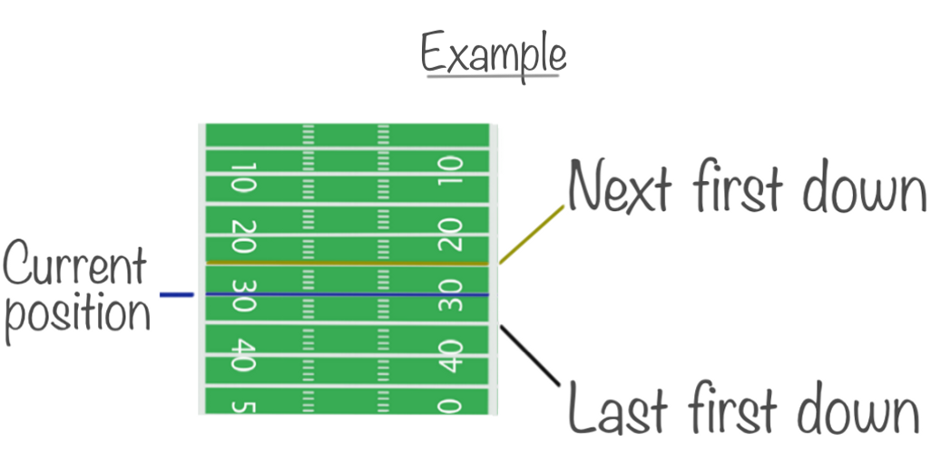
NFL Game: Rundown
Games played in a play-by-play format
4th downs are our area of focus
Several strategic options on fourth down:
Go for it, punt, or kick a field goal
Our project will focus on when the team “goes for it”
We wanted to check if the success of converting 4th downs matched what was expected before the play happened
Notes:
Games are played in a play-by-play format. If you fail to get 10 yards in 4 plays the opponent gets the ball.
4th downs are our area of focus for this project
There are several options on fourth down
For example you can go for it, punt, or kick a field goal
We are focusing on when the team goes for it.
We wanted to see how modeling successfully converted 4th downs or not coincided with preconceived notions before the play happened.

Slide 3
Introduction to the dataset
NFL Play Data Overview (Since 1999)
Includes all NFL plays, regular season and playoffs.
Advanced metrics from 2006
Built-in analytics: Expected Points, Win Probability.
Data Accessibility
Regularly updated.
Easy updates with update_db() function.
Notes:
Sowmya Overview of the Dataset: This dataset is comprehensive, covering every play in the NFL starting from 1999, including both regular season games and postseason contests.
Advanced Metrics: Starting in 2006, the dataset includes advanced metrics like Completion Percentage Over Expected (CPOE) and Expected Yards After the Catch (XYAC). These metrics provide deeper insights into player performance and play outcomes.
Analytical Tools: The dataset is equipped with models for Expected Points and Win Probability, among others. These tools are crucial for enhancing game analysis and making accurate forecasts.
Accessibility and Updates: The data is readily accessible and is regularly updated to ensure the most current information is available during the NFL season. The package also includes user-friendly functions, such as update_db(), which simplifies the process of keeping your local datasets current.
Importance for Users: This dataset is invaluable for analysts, coaches, and fans who want to engage deeply with detailed play analysis and game forecasting. The accessibility features ensure that even users with minimal technical skills can work effectively with the data.

Slide 4
Key Variables in NFL Data Analysis
Yards & Timing
ydstogo: Yards for a first down
game_seconds_remaining: Game time left
seconds_remaining_from_drive_start: Time since drive start
play_clock: Play clock time at snap
Play Type & Position
is_pass: Indicates if the play is a pass (1) or not (0)
yardline_100: Distance from opponent’s end zone
shotgun: Indicates shotgun formation (1) or not (0)
Game Context
score_differential: Score difference between teams
drive_play_count: Plays run in current drive
Environmental Conditions
temp: Game temperature (default 70°F for domed)
wind: Wind speed (default 0 for domed)
Timeouts
timeout_before: Timeout called before play (1) or not (0)
Notes:
Sowmya This dataset includes key variables that describe each play's context, setup, and environmental conditions, allowing for a detailed analysis of strategies and outcomes.
ydstogo shows the distance needed to secure a first down.
game_seconds_remaining and seconds_remaining_from_drive_start help analyze time management strategies within games and individual drives.
play_clock provides insight into how quickly teams are setting up plays.
is_pass comes from a conversion of play_type, distinguishing between passing and running plays.
yardline_100 and shotgun provide insights into team positioning and tactical setups, respectively.
score_differential is crucial for understanding the pressure on the playing teams.
drive_play_count helps in analyzing drive strategies and fatigue factors.
Adjustments are made for temp and wind with defaults set for plays in domed stadiums, indicating controlled conditions that could affect play decisions.
timeout_before indicates strategic pauses before plays, which can be pivotal in high-pressure situations.
These variables are essential for anyone analyzing game strategies, player performances, or developing predictive models based on detailed play-by-play data.

Slide 5
Hypothesis and Our Predictions
Hypothesis/Investigative Question:
How do game strategies and environmental factors prior to the 4th down play influence whether the 4th down is converted or not?
Our Predictions:
Columns that we thought would be the most important:
Notes:
Sowmya
We are investigating how game strategies and environmental conditions influence the success of converting 4th downs in NFL games. This helps to understand the factors that most significantly impact critical play decisions and outcomes. We had a couple variables in mind before going into analysis that we thought would be the most important which includes:
- `ydstogo`: The necessary yards remaining might indicate how likely a team is to attempt riskier plays.
- `is_pass`: Whether the play is a passing play could suggest different success rates based on passing efficacy.
- `game_seconds_remaining` and `seconds_remaining_from_drive_start`: These timing factors can influence the urgency and type of play chosen.
- `score_differential`: Teams might behave differently when leading versus trailing.
- `yardline_100`: Position on the field can dictate the risk associated with going for a conversion.
- `play_clock`: The time pressure might affect the play's execution.
- `temp` and `wind`: Environmental conditions that could affect the play’s execution, especially for passing.
- `shotgun`: The formation used might correlate with a team's confidence in passing or creating space for running.
- `drive_play_count`: Fatigue or defensive adjustments could impact play success.
- `timeout_before`: A timeout might indicate planning or resetting strategies, which could affect the outcome.

Slide 6
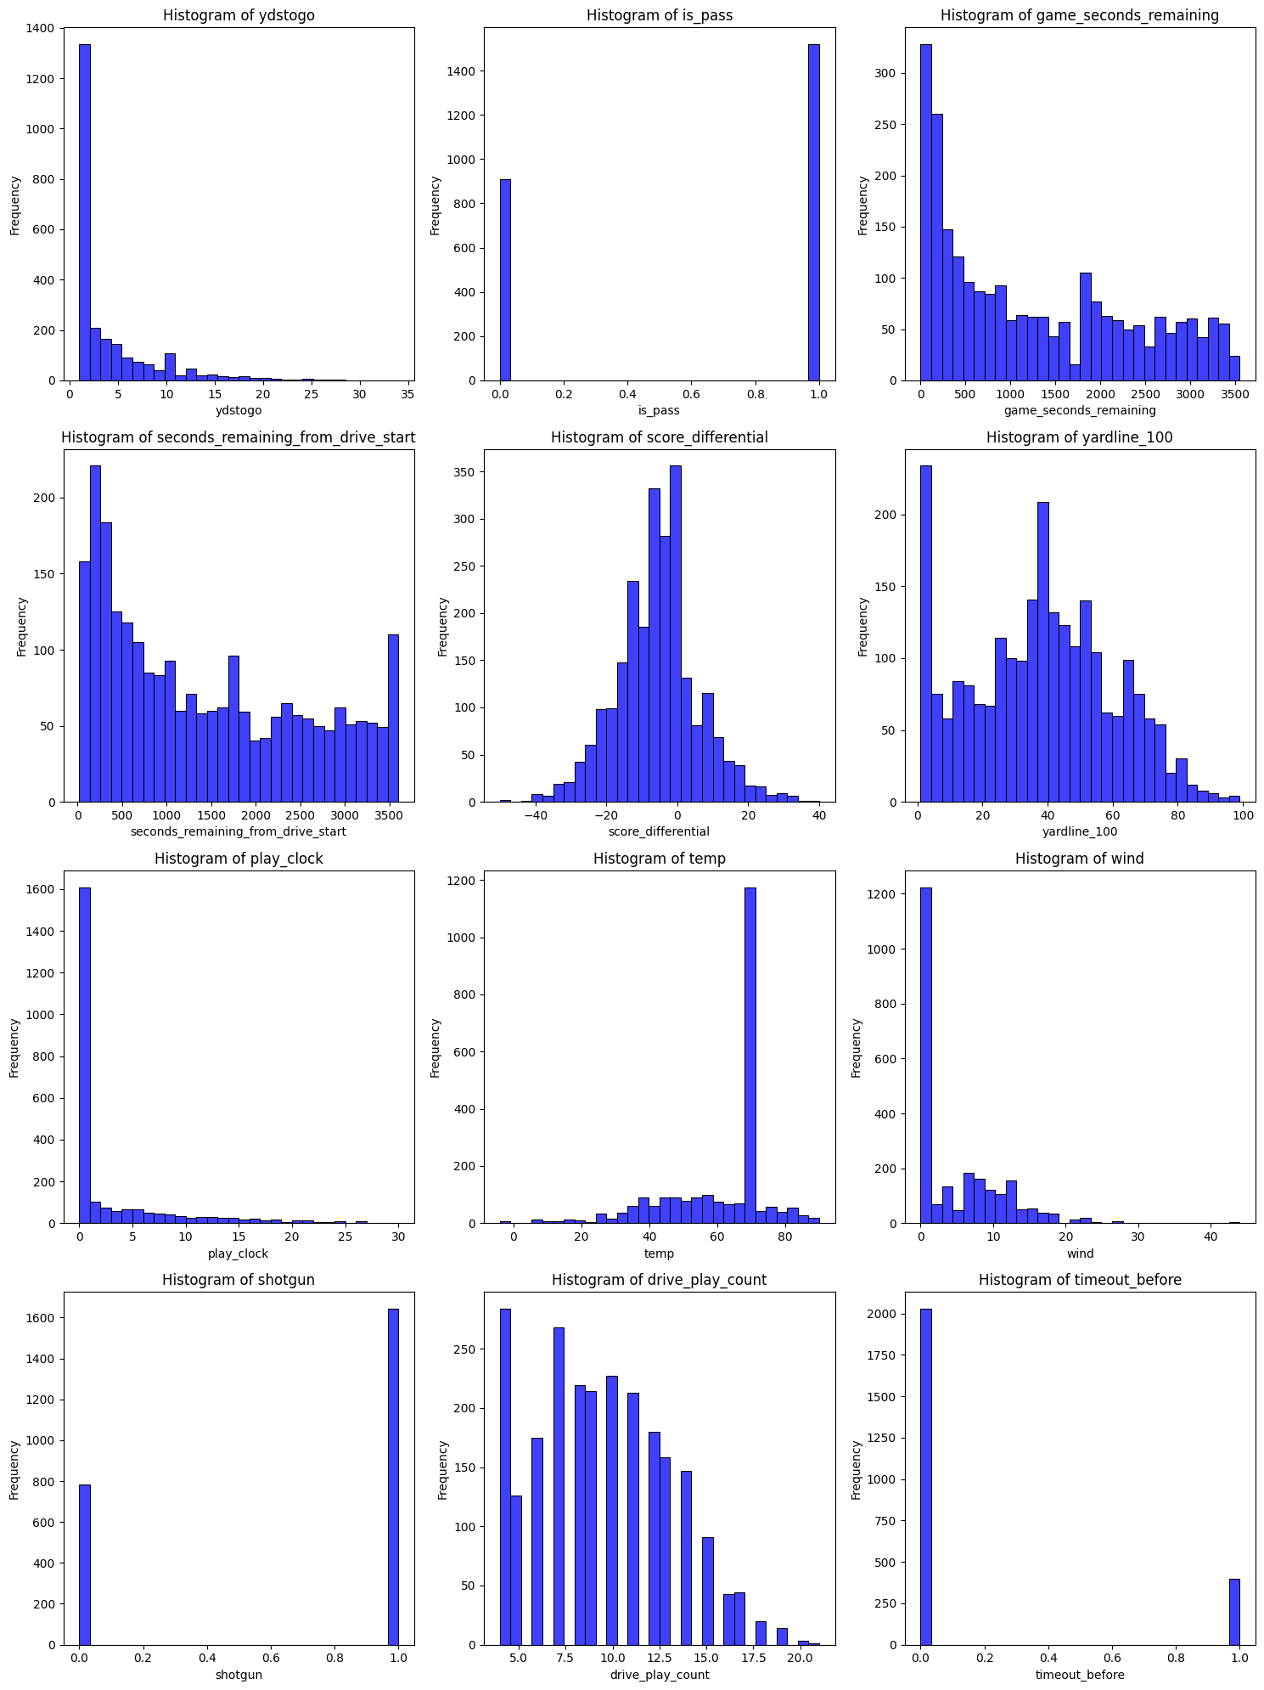
Cleaning and Prepping data:
Histograms to see if scaling was needed:
Split data into training and testing sets for validation
Notes:
Sowmya This process helps identify any issues that might affect our findings, such as outliers, missing values, or data entry errors.These visualizations are used to examine the distribution of our main variables. By looking at these histograms, we can determine whether any scaling or transformations are necessary to normalize the data, which is important for many statistical methods.

Slide 7
Models attempted
Wanted a Classification model to predict if a play would result in a 4th down conversion
SVM
Logistic Regression
Decision Tree
Determined which was best via grid search
Notes:
Jason

Slide 8
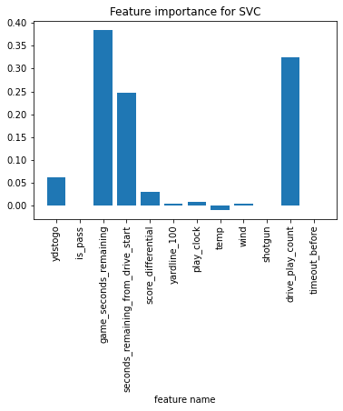
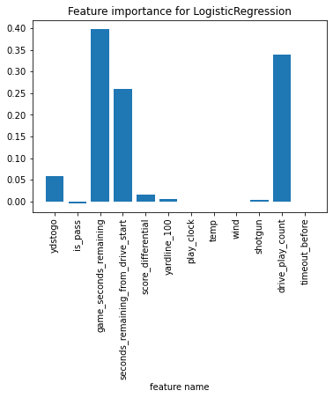
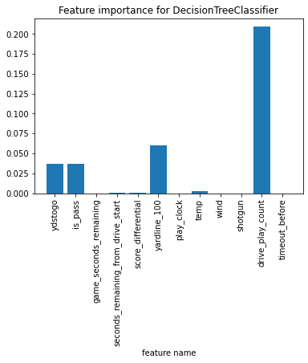
Permutation Feature
Importance:
Notes:
Alec

Slide 9
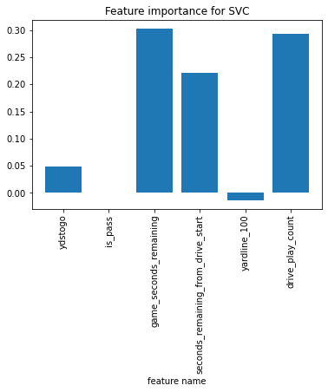
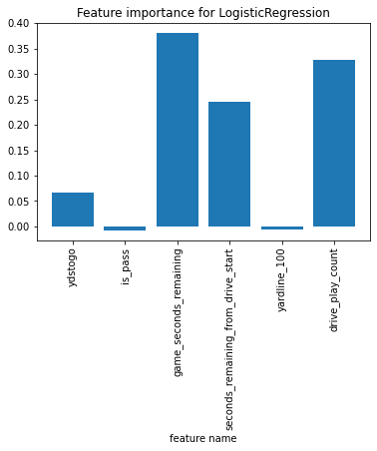
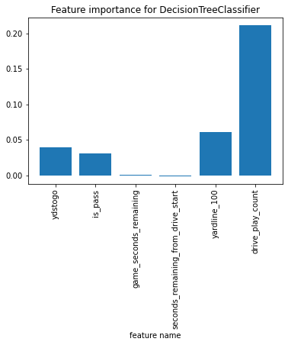
After Feature Selection
Notes:
Alec

Slide 10
Grid Search
Model | Parameters | Best Parameters | Score
SVM | Kernel: linear, rbf C: 0.01, 1, 10, 100, 1000 max_iter: 10000 | Kernel: rbf C: 1000 | 0.815
Logistic Regression | C: 0.001, 0.01, 0.05, 0.1, 1, 10, 100, 1000 max_iter: 5000 | C: 0.01 | 0.848
Decision Tree | criterion: entropy max_depth: 1, 3, 5, …, 15 | criterion: entropy max_depth: 5 | .782
Notes:
Alec

Slide 11
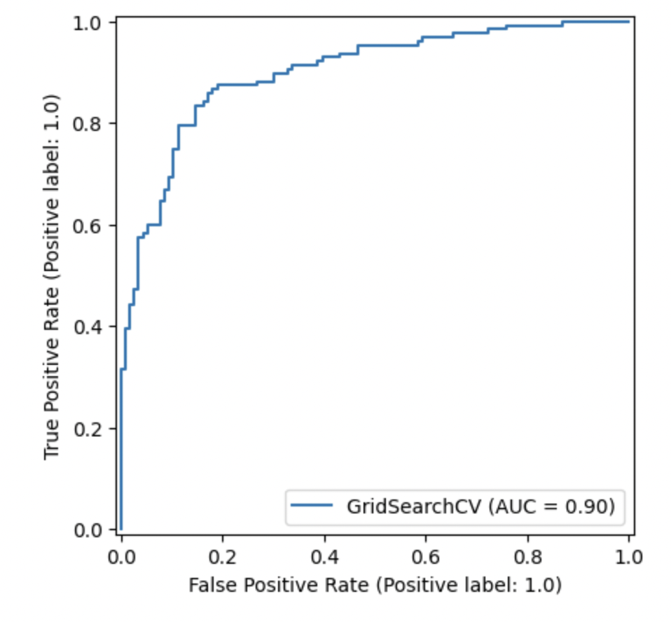
Evaluating Model Performance with ROC Curve Analysis
ROC Curve Insights:
Curve Analysis: smooth progression towards the top-left corner, indicating excellent model performance.
AUC Score: score of 0.90 signifies a very high ability of the model to distinguish between the two classes
Interpretation: A high TPR with a low FPR across thresholds emphasizes the model's effectiveness in making accurate predictions.
Conclusion:
Model Reliability: model reliably identifies positive cases with minimal error
Decision Making: This model can be confidently used for strategic decision-making
Future Steps: Based on this performance, further deployment of the model could be beneficial to refine predictions and understand key influencers.
Notes:
Jason (e.g., whether a play results in a fourth down conversion or not).
A high true positive rate (TPR) with a low false positive rate (FPR) across thresholds emphasizes the model's effectiveness in making accurate predictions.
Model Reliability: model reliably identifies positive cases with minimal error, making it an excellent tool for predictive tasks in our NFL dataset.

Slide 12
Relevance and Takeaway
Feature Takeaways:
Drive_play_count returned the best.
Shotgun and run/pass results disappointing.
Timeouts, a limited resource, weren’t a strong factor.
Score differential was surprisingly not a strong presence in any form.
Time remaining variables indicate earlier the better.
Key Economic Concepts
Strategic Decision-Making:
Data analytics guide teams on whether to attempt plays like fourth-down conversions based on assessments of potential risks and rewards, aligning decisions with economic principles like opportunity cost.
Resource Optimization:
Analytics improve the allocation of resources such as players and coaching strategies, leading to more efficient management and enhanced team performance.
Notes:
Jason

